Slide 1
Historical Thinking Concepts

Slide 2
Historical Thinking Concepts
Adapted from
The big six historical thinking concepts
by peter seixas and tom morton
Published by nelson education

Slide 3
Historical Significance

Slide 4
Historical Significance Activity
Create a timeline to illustrate the twenty most significant events in … history or, the history of our planet or, human history or the history of the 20th Century or, …

Slide 5
Historical Significance
Events, people or developments have historical significance if they resulted in change.
That is, they had deep consequences, for many people, over a long period of time.
Guidepost 1

Slide 6
Historical Significance
Events, people, or developments have historical significance if they are revealing.
That is, they shed light on enduring or emerging issues in history of contemporary life.
Guidepost 2

Slide 7
Historical Significance
Guidepost 3
Historical significance is constructed.
That is, events, people, and developments meet criteria of historical significance only when they are shown to occupy a meaningful place in a narrative.
Did it result in change?
Did it reveal something?
The narrative tells what happened.
Historical Significance established.

Slide 8
Historical Significance
Guidepost 4
Historical significance varies over time and from group to group.
This "heroic" scene of Columbus "discovering" America erroneously depicts the event that led to the demise of Taino culture in less than one generation.

Slide 9
Cause & Consequence

Slide 10
Cause and Consequence
Change is driven by multiple causes, and results in multiple consequences.
These create a complex web of interrelated short-term and long-term causes and consequences.
Guidepost 1

Slide 11
Cause and Consequence
The causes that lead to a particular historical event vary in their influence, with some being more important than others.
Guidepost 2

Slide 12
Cause and Consequence
Guidepost 3
Events result from the interplay of two types of factors: (1) historical actors, who are people (individuals or groups) who take actions that cause historical events, and (2) the social, political, economic, and cultural conditions within which the actors operate.
Adolf Hitler attends a rally in the Munich Odeonsplatz to celebrate the declaration of war in 1914.

Slide 13
Cause and Consequence
Guidepost 4
Historical actors cannot always predict the effect of conditions, opposing actions, and unforeseen reactions. These have the effect of generating unintended consequences.

Slide 14
Cause and Consequence
Guidepost 5
The events of history were not inevitable, any more than those of the future are. Alter a single action or condition, and an event might have turned out differently.

Slide 15
Continuity & Change

Slide 16
Continuity & Change
Continuity and change are interwoven: both can exist together. Chronologies – the sequencing of events – can be a good starting point.
Guidepost 1

Slide 17
Continuity & Change
Change is a process, with varying paces and patterns. Turning points are moments when the process of change shifts in direction or pace.
Guidepost 2

Slide 18
Continuity & Change
Guidepost 3
Progress and decline are broad evaluations of change over time. Depending on the impacts of change, progress for one people may be decline for another.
John Gast’s American Progress

Slide 19
Continuity & Change
Guidepost 4
Periodization helps us organize our thinking about continuity and change. It is a process of interpretation, by which we decide which events or developments constitute a period of history.

Slide 20
Historical Perspective

Slide 21
Historical Perspective
Guidepost 1
An ocean of difference can lie between current worldviews (beliefs, values, and motivations) and those of earlier periods of history.

Slide 22
Historical Perspective
It is important to avoid presentism – the imposition of present ideas on actors in the past. Nonetheless, cautious reference to universal human experience can help us relate to the experience of historical actors.
Guidepost 2

Slide 23
Historical Perspective
The perspectives of historical actors are best understood by considering their historical context.
Guidepost 3

Slide 24
Historical Perspective
Taking the perspectives of historical actors means inferring how people felt and thought in the past. It does not mean identifying with those actors. Valid inferences are those based on evidence.
Guidepost 4

Slide 25
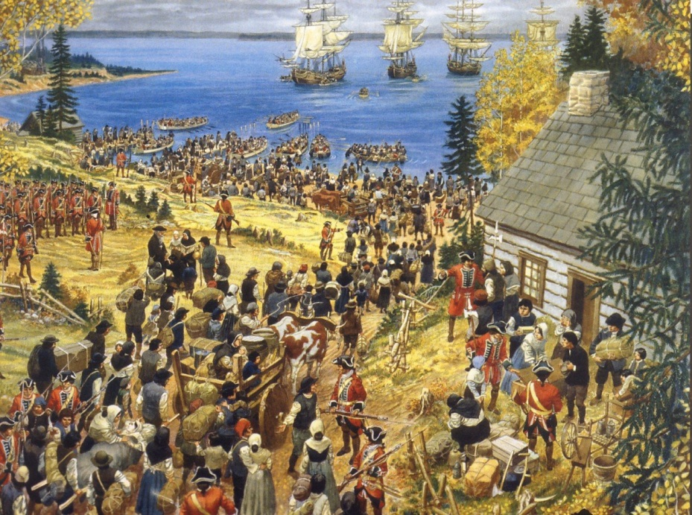
Historical Perspective
Guidepost 5
Different historical actors have diverse perspectives on the events in which they are involved. Exploring these is key to understanding historical events.

